Slide 1
Entity Types

Slide 2
Two types of Entities
Strong Entity
Weak Entity

Slide 3
STRONG ENTITY

Slide 4
Strong Entity
An entity that has an primary key is termed a strong entity.
The Strong entity is independent of any other entity
C_name
C_city
C_phone
C_id
Customers

Slide 5
Weak Entity

Slide 6
Weak Entity – Part 1
An entity set may not have sufficient attributes to form a primary key. Such an entity is called as weak entity.
As the weak entities do not have any primary key, they cannot be identified on their own, so they depend on Strong Entity.
The weak entities have total participation constraint in its identifying relationship with Strong Entity.

Slide 7
Weak Entity – Part 2
Weak entity types have partial keys. Partial Keys are set of attributes with the help of which the tuples of the weak entities can be distinguished and identified.
Note –
  Weak entity always has total participation
  But Strong entity may not have total participation.

Slide 8
Notations for Weak Entity
Weak entities are represented with double rectangular box
Relationships are represented with double diamond
Partial Key attributes are represented with dotted lines.

Slide 9
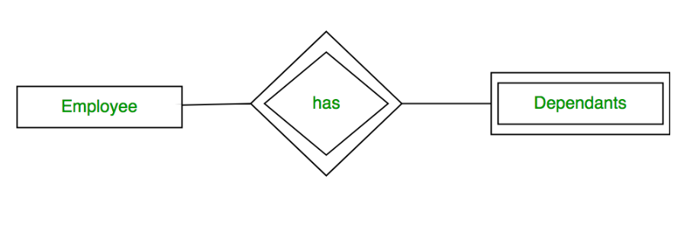
Example of Weak Entity
Refer the above example: A company may store the information of dependents (Name of Parents, Number of Children, Name of Spouse) of an Employee.
But the dependents don’t have existence without the employee.
So Dependent will be weak entity type and Employee will be Strong Entity.

